Slide 1

SALES/PROFIT PREDICTION OF A SUPERMARKET
BATCH NO: ML1-09
PROJECT MEMBERS:
Deepamahi Boddapu
Divya Jyoti Chinera
Shubhangi Narayan
GUIDED BY
Rakesh Manvada

Slide 2


SLIDE MAP
Project abstract
Terminology used
Existing System
Block Diagram
Proposed System
System Architecture
Project Description
System Requirement
Advantages
Implementation
Results
Conclusion
References
www.techionary.info

Slide 3
ABSTRACT
The purpose of this study is to describe the determinants of profitability in terms of the strategic profitability model, depicting the “route” to high profitability in grocery retail stores located in market areas possessing dissimilar competitive conditions. Different physical characteristics (e.g. store formats) have traditionally been used as control criteria, but it is argued in this paper that management principles in retail chains should be based on different clusters of stores, formed from local competitive conditions.
The research results are derived from local competitive conditions and the performance of supermarkets, and controlled by one retail chain. The findings show that the “route” to profitability significantly differs between the clusters.
Practical implications – Supermarkets under different competitive conditions have different critical success factors and would probably be better managed, supported and evaluated on a different basis, i.e. retail chains need to adjust their approach to their supermarkets depending on local competitive conditions.
www.techionary.info

Slide 4
TERMINOLOGY USED
Supervised Learning: Supervised learning is an approach to creating artificial intelligence (AI), where the program is given labeled input data and the expected output results.
Regression: Regression prediction is the task of approximating a mapping function (f) from input variables (X) to a continuous output variable (Y).
Polynomial regression: Polynomial regression is a form of regression analysis in which the relationship between the independent variable x and dependent variable y is modelled as an nth degree polynomial in x.
Formula for polynomial regression is
y=a0+a1*x1+a2*x1^2+a3*x1^3……..ai*x1^i
y=dependent variable
x1=independent variable
a0=constant
ai=slope coefficient for each independent variable
R2_Score: R-squared (R2) is a statistical measure that represents the proportion of the variance for a dependent variable that's explained by an independent variable or variables in a regression model.
www.techionary.info

Slide 5
EXISTING SYSTEM
Earlier, the businessmen or the people who were associated in this profession, used to face a lot of problems in tracking their profits, and losses.
They used to manually write all their calculations and the profits in their account books, and had to do more efforts.
They had to think a lot, in order to increase their profits in their business and what might be the trends so that their production increases. This was quite a tedious task, as all they had to do manually and with some skillful persons.
But this was a time taking process, because analysing trends, and the behaviour of customers could take many days, which could be a huge disadvantage to the business persons.
It would cost the businessmen a huge loss, because by the time they, could figure out what are the loopholes in their business, already some other businessmen would have opened a new Supermarket with some nice and new things, which would attract the customers.
So in order to, overcome this, we had proposed a basic Machine Learning Model, which could help the businessmen in predicting their profits, and understanding the trends to increase their profits.
www.techionary.info

Slide 6
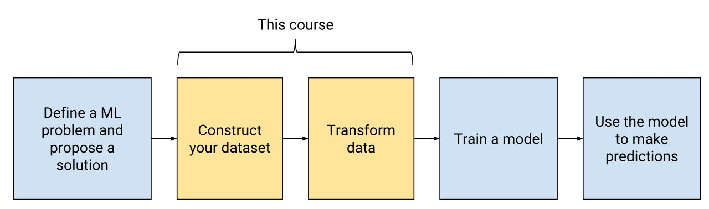
BLOCK DIAGRAM
www.techionary.info

Slide 7

PROPOSED SYSTEM
In order to overcome the problem, which was in existing system, we had proposed a basic Machine Learning Model, which can predict and analyse the trends of their business.
As in this Model we have taken a basic dataset, of Supermarket, which consists of, 5 attributes, 4 are input (independent variables) and 1 is output (dependent variables).
Here we have taken, the basic, requirements of a supermarket like Grocery, Clothing, Electronics and in which region, these are the input attributes.
So, on basis of these independent variables, we are predicting profits, that whether which region’s Supermarket is gaining more profits, in terms of which criteria.
www.techionary.info

Slide 8
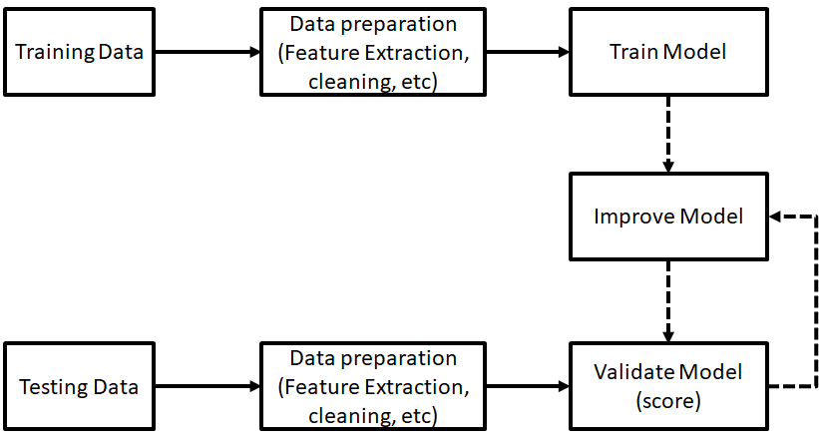
SYSTEM ARCHITECTURE
www.techionary.info

Slide 9
PROJECT DESCRIPTION
Regression is an important machine learning model for these kinds of problems. Predicting sales of a company needs time series data of that company and based on that data the model can predict the future sales of that company or product.
So, in this research project we will analyze the time series sales data of a company and will predict the sales of the company for the coming quarter and for a specific product.
www.techionary.info

Slide 10
SYSTEM REQUIREMENTS
SKLEARN.PREPROCESSING
NUMPY
TRAIN_TEST_ SPLIT
REQUIREMENTS
SEABORN
PANDAS
MATPLOTLIB
www.techionary.info

Slide 11
ADVANTAGES
1.Promotions (including Coupons) :
Without being really conscious about it, shoppers give away a lot of details about themselves to retailers through their offline, and now online, activities. Every time they download some online information or cut out a newspaper coupon, or pick up that flyer from the checkout counter, they send out signals to the retailer. Even the method of payment says something about them.
2.Pricing :
Predictive Analytics can give considered answers to several questions that are in the minds of the retailers who often use pricing as a tool to pull in customers:
--What is the correct price point to maximize sales?
--How often to launch price-based promotional activities?
--What is a customer’s optimal attainable price?
--What would be the impact of competitive pricing on sales?
www.techioanry.info

Slide 12
IMPLEMENTATION
The project is implemented in six different steps:
Step 1: Importing libraries-Importing all the essential libraries like, pandas, numpy, matplotlib, sns etc.
Step 2: Importing dataset-Took the dataset from Kaggle.com.
Step 3: Handling missing data-We didn’t have any null values in our dataset, so there was no need of filling the missing values.
Step 4: Separating independent and dependent variables-We had 4 attributes as input and 1 attribute as output.
Step 5: Encoding categorical values-There was one attribute, called Region which has to encoded to numerical values.
Step 6: Splitting train and testing data-And at last we had done the train and test method, so as to predict the value.
Step 7: Prediction and Visualization-We have predicted the accuracy with r2_score method.
www.techionary.info

Slide 13
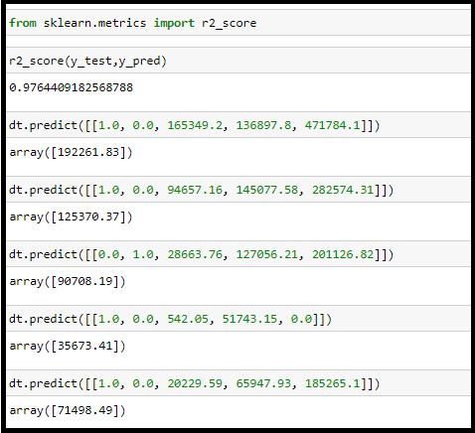
RESULT
We developed the model by using three different regression algorithms in machine learning. Those are, Multilinear, Polynomial Regression, Decision Tree Regression.
By training the model with all these three algorithms , an accuracy of 93.47% with multi linear regression; 98.80% with polynomial regression; 97.64% with decision trees is obtained.
So by best fit algorithm, we built the model by decision tree regression.
www.techionary.info

Slide 14
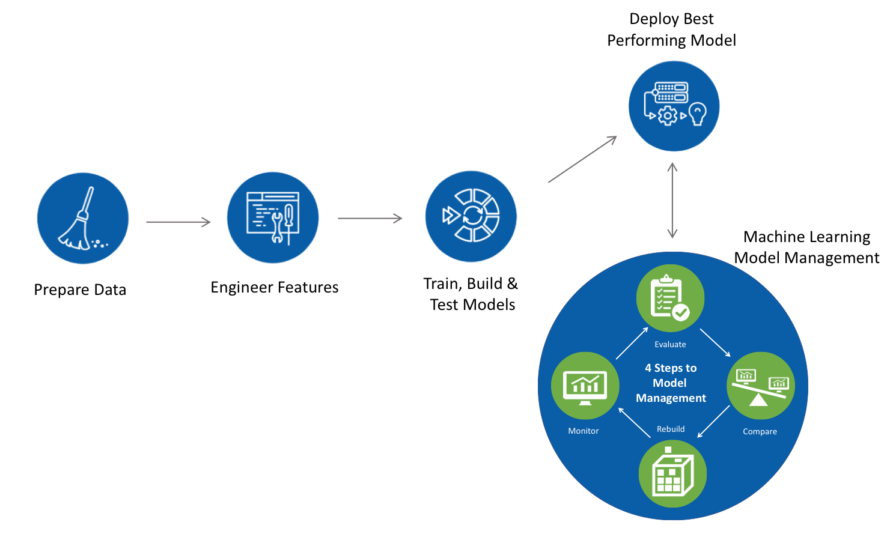

CONCLUSION
After training the dataset with 80% of data and testing the dataset with 20% of data, an accuracy of 97.64% is obtained using Decision Tree regression.
www.techionary.info

Slide 15



REFERENCES
Dataset:- Kaggle.com
Information:- Wikipedia
Images:- Google Images.
www.techionary.info

